Slide 1
US Healthcare 101
An introductory course on US Healthcare

Slide 2
Instructor
Wasif Toor
18+ years experience in US Healthcare Industry
Software Engineer by training
Then transition into Business Analyst
Now working as Project Manager (VP Oncology)
Worked in:
ERP Systems (Enterprise Resource Planning)
Inventory Management System
EHR Systems (Electronic Health Record)

Slide 3
Objective
Core nature of Industry
Importance of work you are doing
The consequences, what would happen if you are not attentive to the work
Problems of the industry
Future of the industry

Slide 4
Size of US Healthcare Industry
Largest employers – 16 million jobs
Healthcare Spending $3.5 trillion, 17.9% of GDP
890,000+ physicians
3 million nurses
168, 000 dentists
208, 000 pharmacists
700,000 administrators
300,000 physical therapy, occupational therapy, speech

Slide 5
Size of US Healthcare Industry
5,810 hospitals
17,000 nursing homes
5,720 mental health hospitals
11,700 home health & hospice agencies
800 primary care programs
300 medical, dental & primary schools
1,500 nursing programs

Slide 6
Impact of Politics
Startup: Cancer Care Docs
Dedicated to cancer treatment
Cabinet System changed
Barack Obama came into government
What would happen if Bernie Sanders will be in government? Bernie is an American politician serving as the senior United States senator from Vermont, a seat he has held since 2007.
According to Bernie “Health care must be recognized as a right, not a privilege”.

Slide 7
Statistics of healthcare
https://policyadvice.net/

Slide 8
Must-Know Healthcare statistics 2020
Global health industry worth was $8.45 trillion in 2018
Global healthcare spending could reach over $10 trillion by 2022
The US has the greatest healthcare spending, sitting at $10,224 per capita
The US spends twice what other countries do on healthcare
There are 784, 626 companies in the US healthcare sector
McKesson is the biggest company with annual revenue of $208.3 billion
IoT can lower costs of operational & clinical inefficiencies by $100 billion/year
64% physicians believe, IoT can help to reduce burden on nurse & doctors
28% population of China uses connected healthcare devices, highest in the World

Slide 9
Modern Healthcare industry
784, 626 companies in US Healthcare industry
1 in 8 US citizens is employed in the US Healthcare industry
The average healthcare employee salary in the US is $60, 976

Slide 10
US Hospital statistics
Numbers of registered hospital are 6, 210
Staffed beds in registered hospitals are 931, 203
Admissions in registered hospitals are 36, 510, 207

Slide 11
Comparison of US states
States with best healthcare
Hawaii
Lowa
Minnesota
New Hampshire
District of Columbia
States with worst healthcare
Louisiana
Mississippi
Alaska
Arkansas
North Carolina

Slide 12
Global healthcare industry revenue
By region (in billions of USD)
North America - $714.5
Europe - $422
Asia-Pacific - $342.4
Japan - $174.4
Latin America - $137.1
The rest the world – $63.4

Slide 13
In 2018, Global Healthcare Industry Market Value Reached $8,452 Billion

Slide 14
In 2022, Global Healthcare Spending Could Reach $10,059 trillion

Slide 15
Healthcare consumption expenditures per capita by country
United States - $10,224
Switzerland - $8,009
Germany - $5,728
Sweden - $5,511
Austria - $5,440
World average - $5,280

Slide 16
What makes healthcare so expensive in America
Healthcare costs are 2x higher in the US than in the rest of the world, mostly because of the expensive treatments and procedures
Healthcare administrative spending accounts for 8% of US GDP compared to 3% in other nations

Slide 17
Health spending by type of products or services
Hospital Care – 33%
Physicians & Clinical Services – 20%
Retails prescription drugs – 10%
Other health. Residential & personal care – 5%
Nursing care facilities & continuing care – 5%

Slide 18
Health spending by sources of funds
Private health insurance – 34%
Medicare – 20%
Medicad – 17%
Out-of-pocket – 10%

Slide 19
Biggest healthcare companies
McKesson
United Health Group
CVS Health
Amerisource Bergen
Cardinal Health
Express Scripts
Anthems
Kaiser Permanente
Aetna
Humana

Slide 20
Current state of connected health
IoT can reduce cost $100 billon or 25% per year
47% of companies are expected to increase their use of connected health devices
With 28% of connected healthcare devices, China is the world’s leader in adopting it
60% of healthcare organizations already implement IoT in their facilities
12% of people around the world use a connected health device
40% of all IoT technology will be health-related by 2020

Slide 21
What do doctors & patients think?
66% of doctors stated that increased use of Iot would reduce the costs
64% of doctors think IoT could reduce the burden on nurses & doctors
74% of patients think sharing information about lifestyle could help doctors treat them more effectively
55% of patients would share their information if this reduces costs
50% of patients would be comfortable with contacting their doctors digitally

Slide 22
The biggest challenges
Digital health ventures
Upskilled workers
Investors have poured $12.5 billion into digital ventures in 2017 and 2018
These investments increased funding levels by 230% compared to 2013
63% of workers said their work requires manual entry or analysis.
45% of executives stated that their worker’s abilities are affecting organizational changes

Slide 23
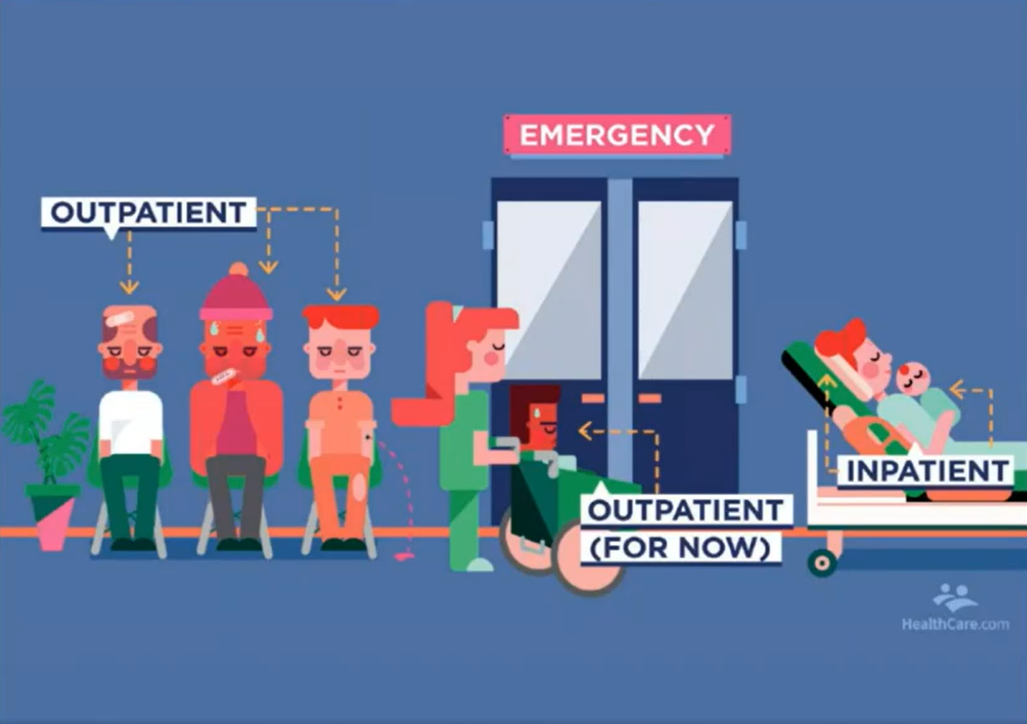

Slide 24
CureMD, 96% business comes from out-patients

Slide 25
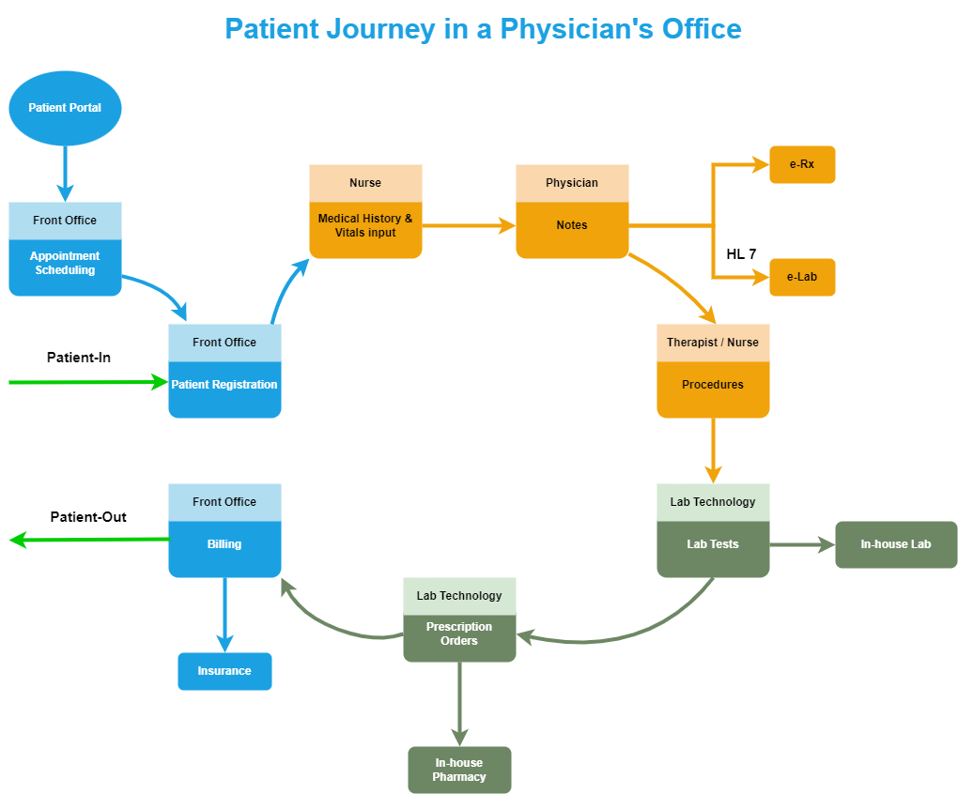

Slide 26
Future
Artificial Intelligence
Natural Language Processing
Digital Receptionist
Automation of Clinical Treatment
Precision Medicine
Preemptive approach for gene abnormalities

Slide 27
Scheduling Appointments
Book appointment
Edit appointment
Reschedule appointment
Confirm appointment
Cancel appointment
Weekly View
Monthly View
Quick Add Patient
Check-In appointment
Search appointment

Slide 28
Checking prescription requests
Electronically send prescription
Comprehensive drug database
Patient prescription history
Re-Prescription one or many
Customizable views
Easily generate reports from anything stored
Approve refill request
Deny refill request
View refill requests and prescription clarification from pharmacies
Change refill request
Pending E-Refills Tab
Automatic Drug Interaction Checks
Print prescription locally

Slide 29
User management
User Authentication
Custom Role Management
Default Roles Management
User Profile Management
User Permission
Audit Log
Two Factor Authentication Management
Group Management
Access Management

Slide 30
Viewing bills/making payments
Cash payments
Online payments
Advance payments
Family payments
Allocations from advances
Claim filing
Be able to associate payment data with an invoice
Patient payment (Copay + Advances)
Credit card payment
Insurance payments

Slide 31
Thank you

